Slide 1

Organizing for Innovation
Based on Schilling. (2022). Chapters 6, 7, and 10
Focus: Structures, Innovation Culture, and Ambidexterity

Slide 2
Learning Objectives
By the end of this lecture, students will be able to:
Compare functional, matrix, and agile structures for innovation.
Explain the role of ambidextrous organizations in balancing exploitation and exploration.
Analyze how culture supports or undermines innovation.
Apply concepts to real-world firms (Netflix, Google).
Design an innovation-friendly team structure for a modern tech company.

Slide 3
Why Organizing for Innovation Matters
Innovation is not just about ideas → it’s about execution.
Organizational design influences:
Speed: How quickly new ideas reach market.
Flexibility: Ability to pivot when markets change.
Creativity: Encouraging new ideas, risk-taking.
Firms with poor organization waste resources, duplicate work, or lose innovators.

Slide 4
Link Between Strategy & Organization
Strategy = what we want to achieve (e.g., become leader in AI-driven services).
Organization = how we achieve it (e.g., team structures, resource allocation).
Misalignment leads to failure:
Strategy says “be innovative” but structure blocks collaboration.
Example: Nokia → great strategy for mobile, but bureaucratic structure delayed responses to iPhone.

Slide 5
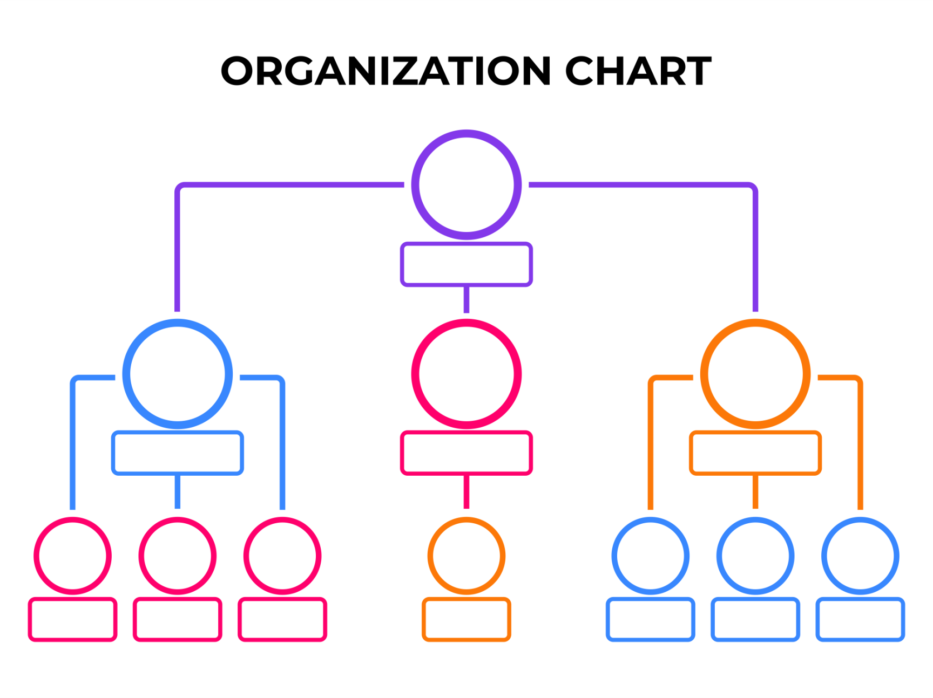
Functional Structure
Organizes employees by specialized function (R&D, marketing, production).
Advantages:
Deep expertise and specialization.
Efficiency through economies of scale.
Disadvantages:
Silos → poor communication across departments.
Innovation projects may get stuck moving between functions.
Example: Traditional car manufacturers before EV disruption.

Slide 6
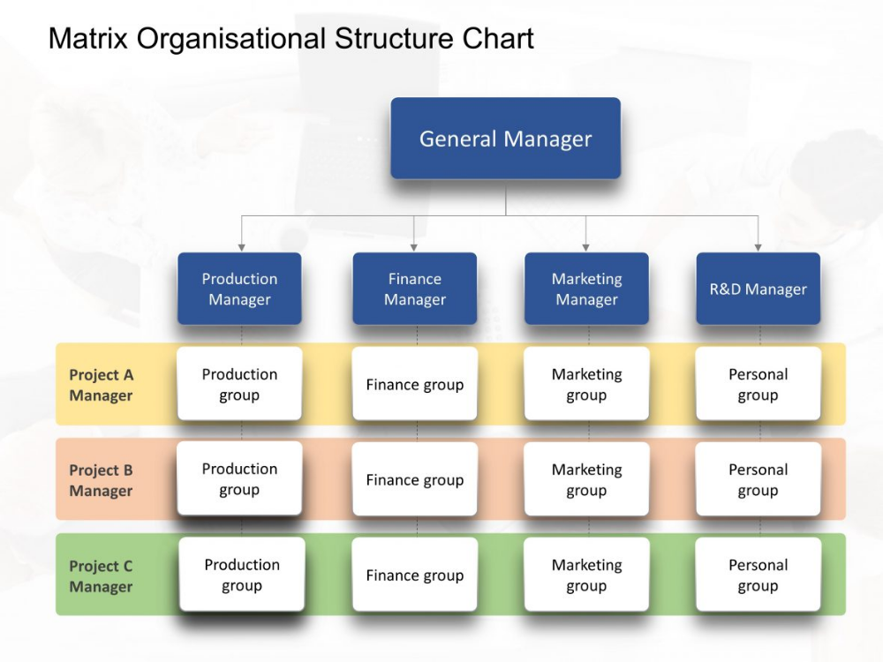
Matrix Structure
Employees report to two managers: functional head + project manager.
Advantages:
Balances specialization with flexibility.
Cross-functional collaboration for innovation projects.
Disadvantages:
Confusion in reporting lines.
Power struggles between managers.
Example: Aerospace and defense industries (Boeing, NASA).

Slide 7
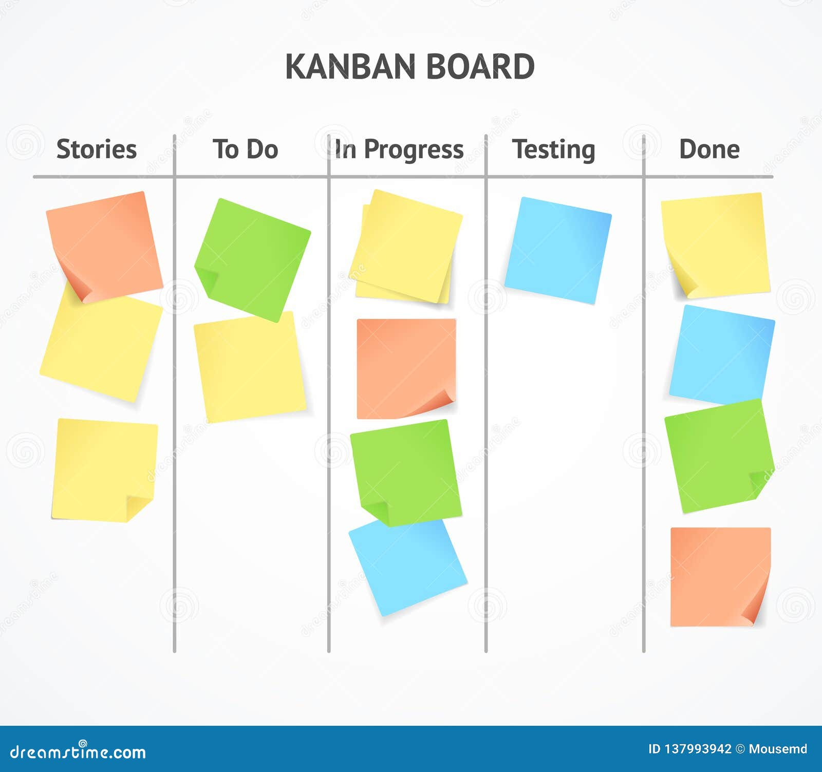
Agile/Project-Based Teams
Teams formed around specific projects → highly cross-functional.
Advantages:
Rapid response to market changes.
Strong ownership and accountability.
Disadvantages:
Duplication of resources across teams.
Potential inefficiency if scaled poorly.
Example: Spotify’s “squads and tribes” agile model.

Slide 8
Comparing Structures
Structure | Strengths | Weaknesses | Best Context
Functional | Specialization, cost efficiency | Silos, slow to innovate | Stable markets
Matrix | Balances expertise & projects | Confusion, conflict | Complex projects
Agile/Project | Fast, innovative | Costly, duplicative | Dynamic tech environments

Slide 9
Theoretical Lens – Ambidextrous Organizations
Challenge: Firms must both exploit existing capabilities and explore new opportunities.
Exploit = refine, improve, scale.
Explore = experiment, risk, discover.
Ambidexterity = separate structures or units that allow both.
Example: IBM (hardware/software exploitation + new AI/quantum exploration).

Slide 10
Google’s 20% Time
Employees could use 20% of their time for side projects.
Created products like Gmail, Google Maps.
Lessons:
Slack time → creativity.
Not all projects succeed, but foster a culture of innovation.
Limitation: Needs psychological safety and tolerance for failure.

Slide 11

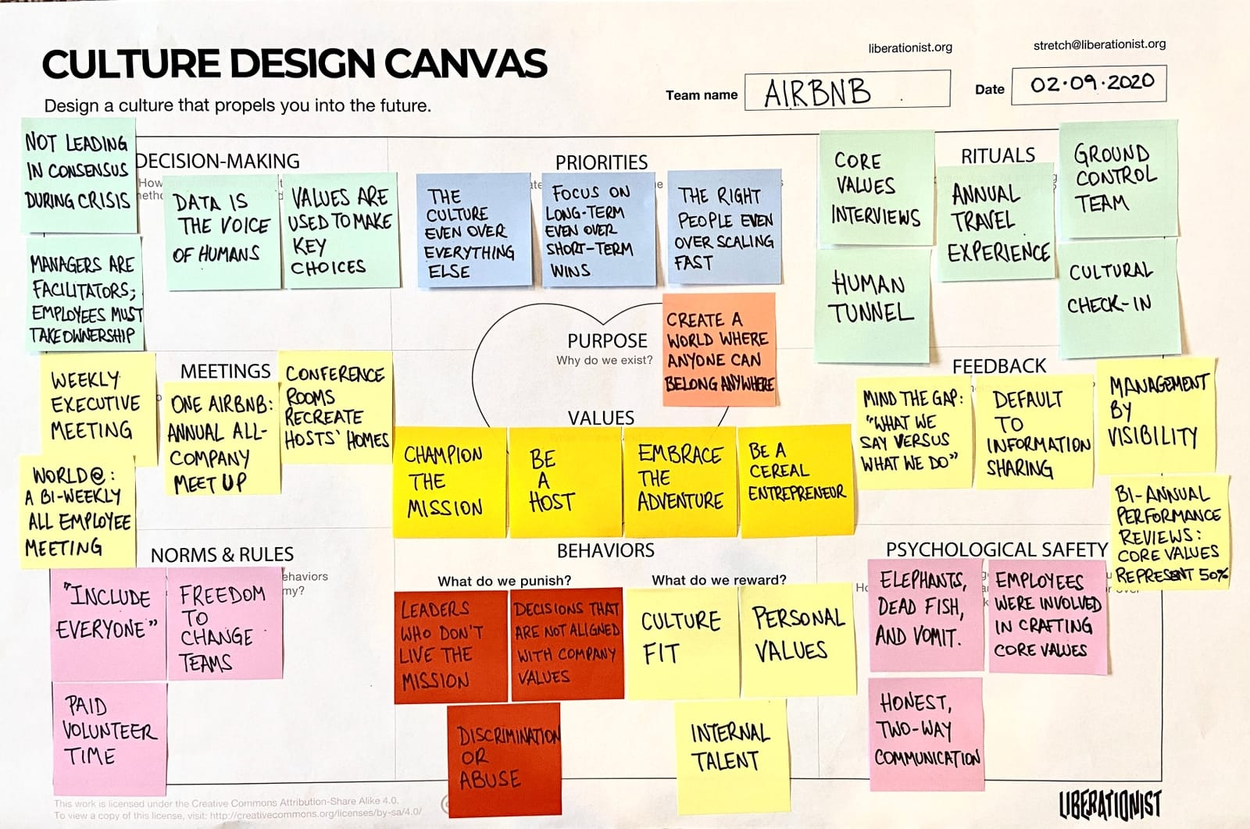
Why Culture is as Important as Structure
Structure creates roles & responsibilities.
Culture creates behavior & mindset.
Innovative culture:
Encourages experimentation.
Rewards learning from failure.
Promotes collaboration across silos.
Example: Pixar’s Braintrust feedback
sessions → candor + creativity.

Slide 12
Netflix Culture Memo (Overview)
Famous “Freedom and Responsibility” culture.
Key points:
Radical transparency and candor.
Few formal policies (e.g., no vacation policy).
Performance-based freedom → employees trusted to act responsibly.
Idea: High talent density + freedom = innovation.

Slide 13
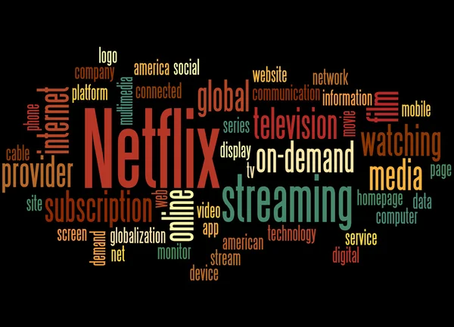
Netflix Culture in Practice
Employees encouraged to take risks without fear.
Decision-making is decentralized.
Emphasis on accountability over micromanagement.
Controversial but effective: high turnover, but high innovation velocity.

Slide 14
HBR Insight – Agile Needs Psychological Safety
Agile fails if teams fear blame or punishment.
Psychological safety = environment where:
Questions are encouraged.
Failures are seen as learning.
Ideas can be challenged respectfully.
Google’s “Project Aristotle”: Psychological safety = #1 factor in team effectiveness.

Slide 15
Organizing for Incremental vs Breakthrough Innovation
Incremental innovation: often fits within existing functional/matrix structures.
Breakthrough innovation: needs separate, flexible, or agile units.
Example: Lockheed Martin’s “Skunkworks” → breakthrough aerospace projects.

Slide 16
Structures for Exploration vs Exploitation
Exploitation → core business, efficiency, reliability.
Exploration → separate labs, R&D centers, or innovation hubs.
Example: Alphabet’s “X” moonshot factory (self-driving cars, balloons).

Slide 17

Organizing Innovation Networks
Beyond internal organization → innovation with partners.
Open innovation → external collaborations, ecosystems.
Example: Tesla open patents accelerated EV ecosystem.

Slide 18
Leadership’s Role in Organizing Innovation
Leaders design both structure and culture.
Must protect innovators from bureaucracy.
Example: Satya Nadella at Microsoft shifted culture from “know-it-all” to “learn-it-all.”

Slide 19
Trade-Offs in Organizing for Innovation
Centralization vs Decentralization
Control vs Freedom
Short-term profit vs Long-term exploration
No single best answer → depends on industry dynamics.

Slide 20
Case Example – Netflix’s Innovation Organization
How does Netflix combine freedom + responsibility in practice?
Talent density ensures quality.
Candor promotes fast feedback.
Few controls allow creativity but rely on accountability.

Slide 21
Case-Based Activity Setup
Case Material: Netflix Culture Deck.
Group Task:
Design a team structure for Netflix’s R&D.
Should reflect freedom + accountability.
Balance creative autonomy with coordination.

Slide 22
Activity Instructions
Form groups of 4–5.
Choose structure (functional, matrix, agile, or hybrid).
Justify design with Netflix’s culture principles.
Present in 2–3 mins.

Slide 23
Example Student Outcomes
Hybrid structure: Agile for creative teams, functional for infrastructure.
Emphasis on accountability metrics instead of strict supervision.
Alignment with culture: High freedom, but high responsibility.

Slide 24
Discussion Questions
Can a culture of freedom replace formal structure?
What risks come with Netflix’s model?
How do psychological safety and candor coexist?
Is Netflix’s approach replicable in all industries?

Slide 25
Linking Back to Schilling Ch. 6 – Strategy Direction
Strategic direction informs organizational choices.
Firms must ask: Do we need efficiency or radical innovation?
Example: Toyota vs Tesla → incremental vs disruptive orientation.

Slide 26
Schilling Ch. 7 – Choosing Innovation Projects
Project selection shapes structure.
Radical projects may need separate structures.
Portfolio management ensures balance between short-term and long-term bets.

Slide 27
Schilling Ch. 10 – Organizing for Innovation
Key lessons:
No single “best” structure.
Balance between specialization and flexibility.
Culture is critical to sustain innovative outcomes.

Slide 28
Metrics for Innovation Organizations
Output metrics: new product revenue, patents, prototypes.
Process metrics: time-to-market, cycle time.
Culture metrics: employee engagement, tolerance for risk.

Slide 29
Challenges in Organizing for Innovation
Resistance to change.
Difficulty scaling agile beyond small teams.
Risk of chaos if freedom is not balanced with accountability.

Slide 30
Future Trends in Organizing Innovation
Hybrid/remote collaboration with digital tools (Slack, Miro, GitHub).
AI-augmented decision-making and ideation.
Web3 & DAOs: decentralized autonomous innovation.

Slide 31
Summary
Structures: Functional, matrix, agile – each has strengths and limits.
Ambidextrous organizations balance exploration & exploitation.
Culture = the hidden structure enabling risk-taking and creativity.
Netflix and Google show contrasting but effective models.
Organizing for innovation is about alignment, balance, and adaptability.

Slide 32

Closing Thought
“Innovation thrives when structure enables freedom, and culture nurtures responsibility.”

